Slide 1

Applied Machine Learning:
Algorithms, Practice and Theory
Logistic Regression and SVM
Koby Crammer
Technion – Israel Institute of Technology

Slide 2

Concepts
Naïve
Bayes
Regularization
Supervised
Learning
Log Reg.
Max Ent.
Loss
Function
Optimization
Binary
SVM
Mistake
Bound
Batch
Learning
Perceptron
PA / MIRA
Generative
Discriminative
Online
Learning

Slide 3
Outline
Naïve Bayes:
  Generative (joint) probabilistic linear model
Logistic regression:
  Discriminative (conditional) probabilistic linear model
  Log-loss
Support Vector Machines:
  Discriminative linear model
  Hinge-loss
  Large Margin, Regularization, Kernels
Models, Inference, Learning

Slide 4
Review of Setting

Slide 5

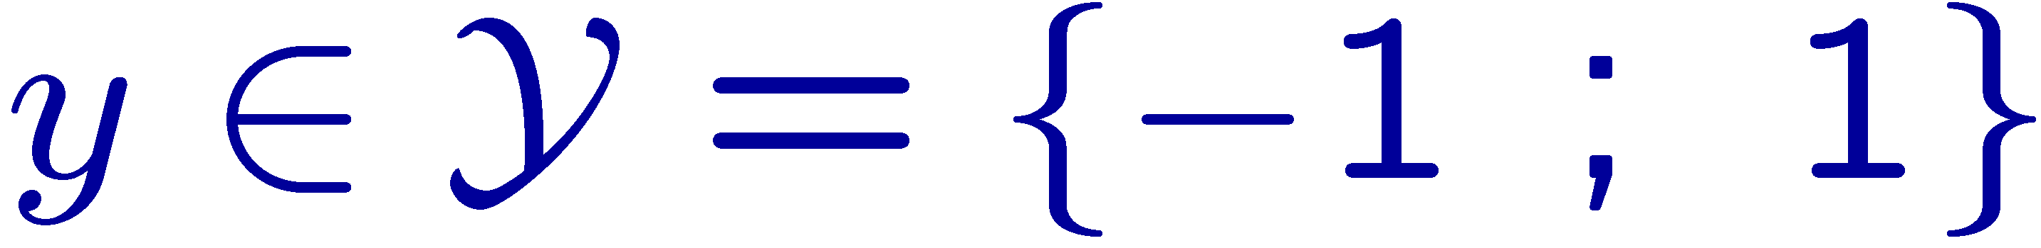

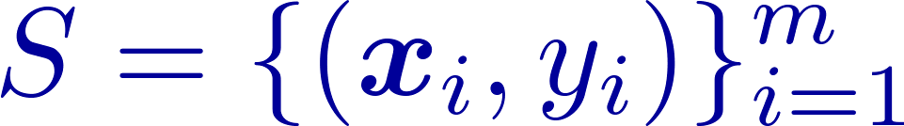
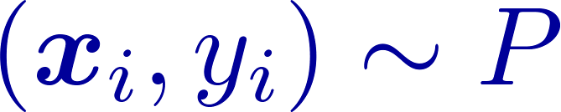
Formal Setting – Data
Instances
  Images, Sentences
Labels
  Binary
Statistical Assumption
  Used for training and
  evaluation
I.I.D. Sample

Slide 6




Formal Setting - Predictions
Continuous predictions :
  Label
  Confidence
Notation:

Slide 7
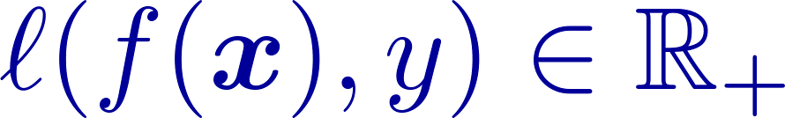
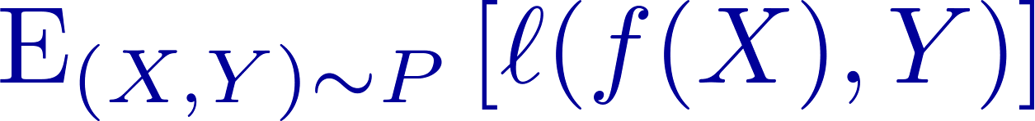
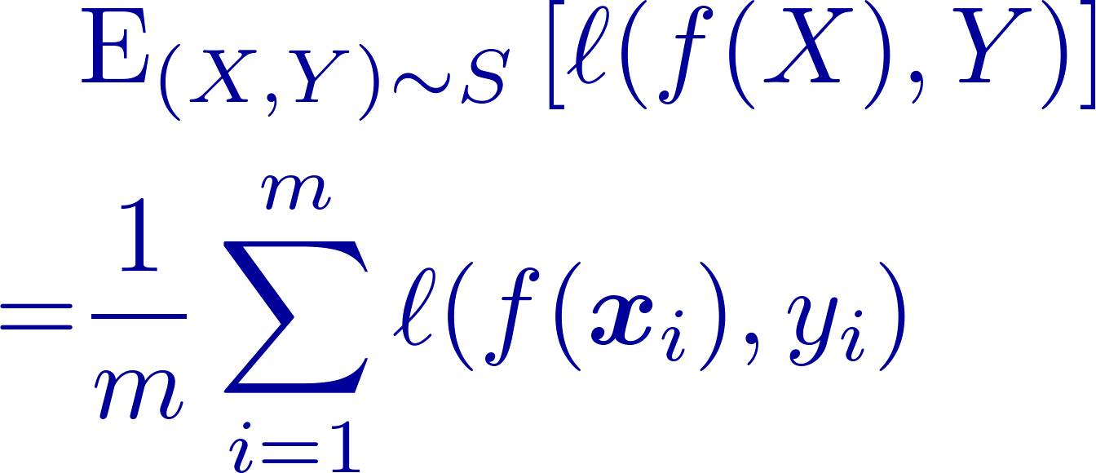
Formal Setting - Evaluation
Loss
  No. of mistakes
Expected Loss
Averaged Loss

Slide 8
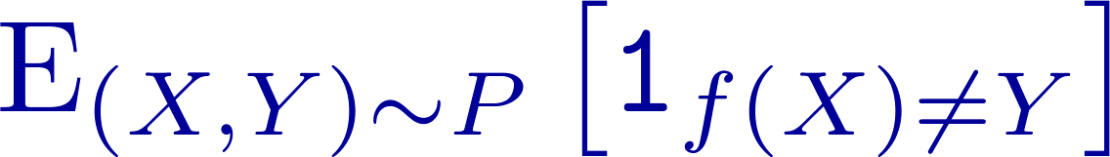
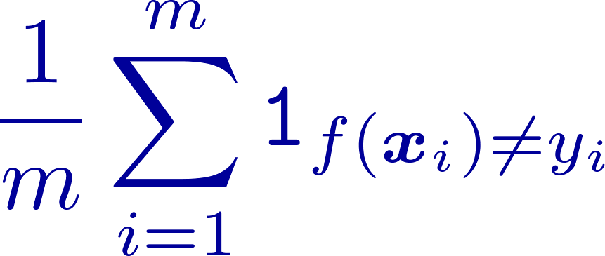
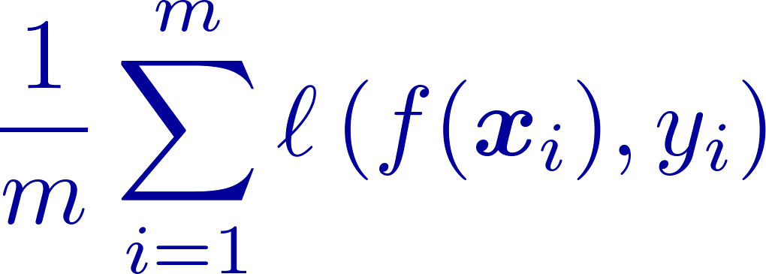
Empirical Risk Minimization
Goal: Minimize classification error
Approximate using Sample:
Bound with “nice” loss

Slide 9
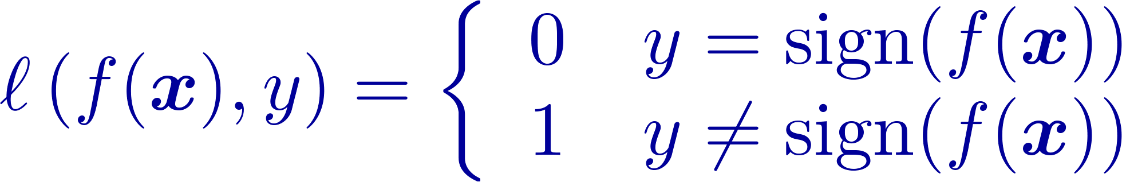
Loss Functions
Natural Loss:
  Zero-One loss:
Real-valued-predictions loss:
  Hinge loss:
  Log loss (Max Entropy, Boosting)

Slide 10
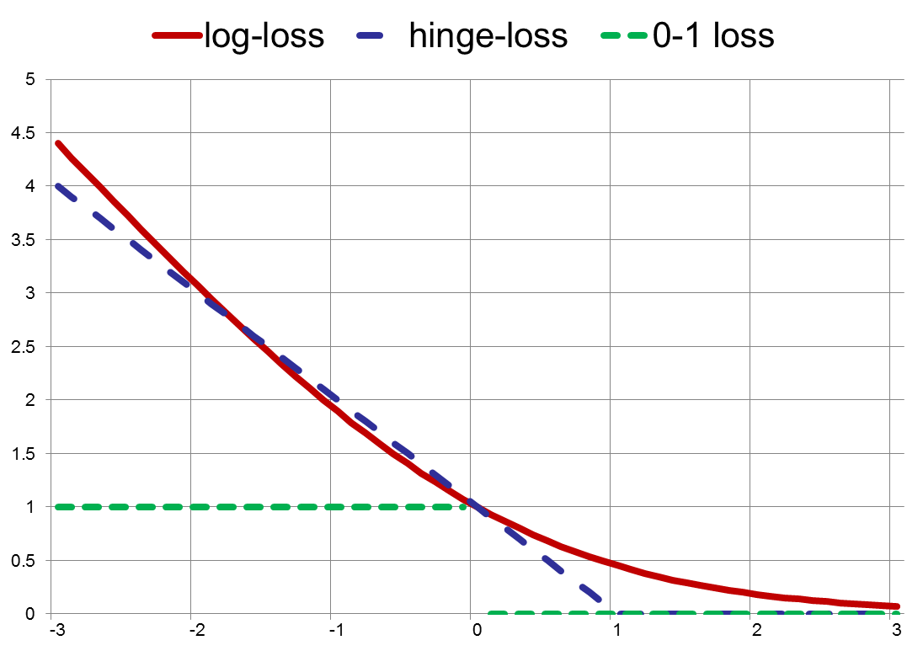


Loss Functions

Slide 11

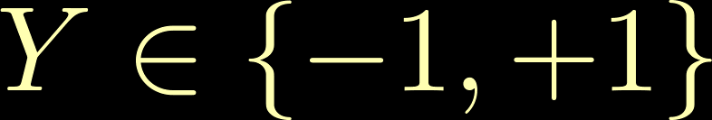
Logistic Regression: Model
Goal:
  Design a discriminative parametric model for the conditional distribution
Binary Classification
Vector Representation of a Document

Slide 12
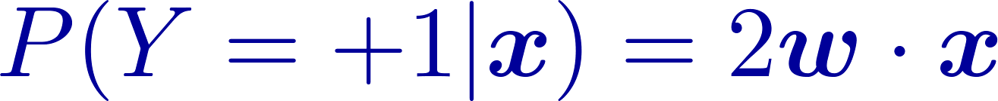
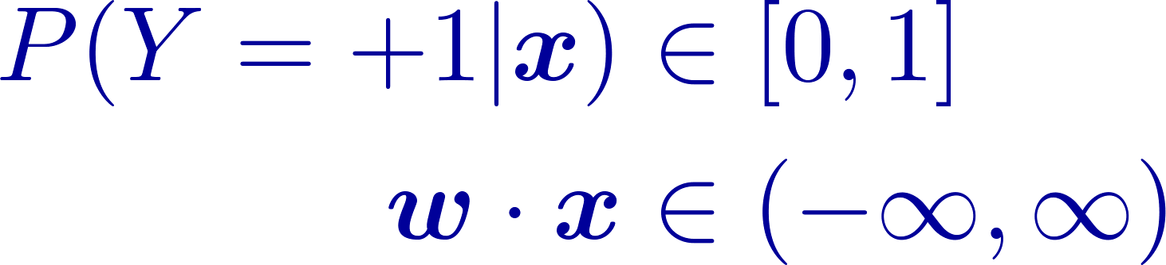
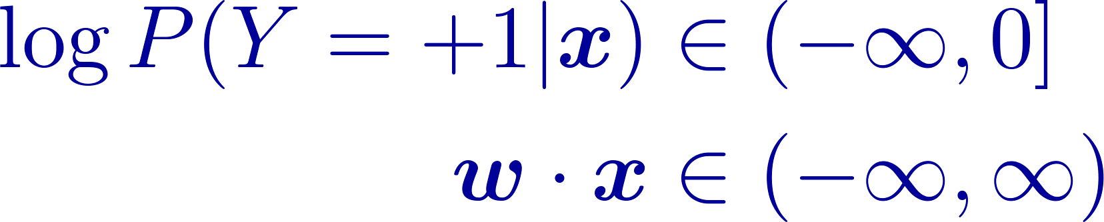
Logistic Regression: Model
Attempt I:
  Problem:
Attempt II:
  Problem:

Slide 13
Logistic Regression

Slide 14
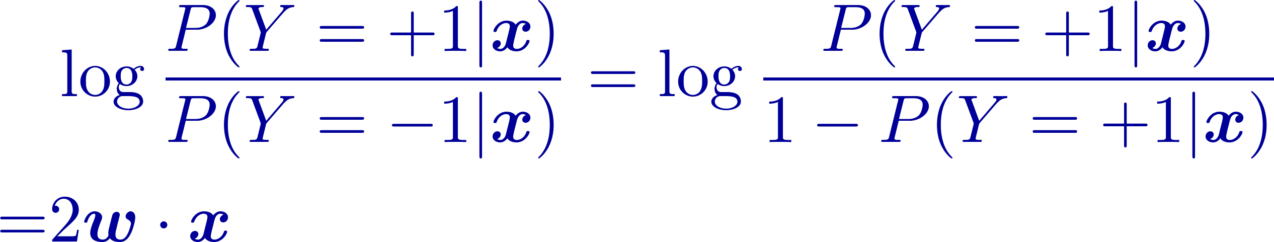


Logistic Regression: Model
Attempt III:

Slide 15
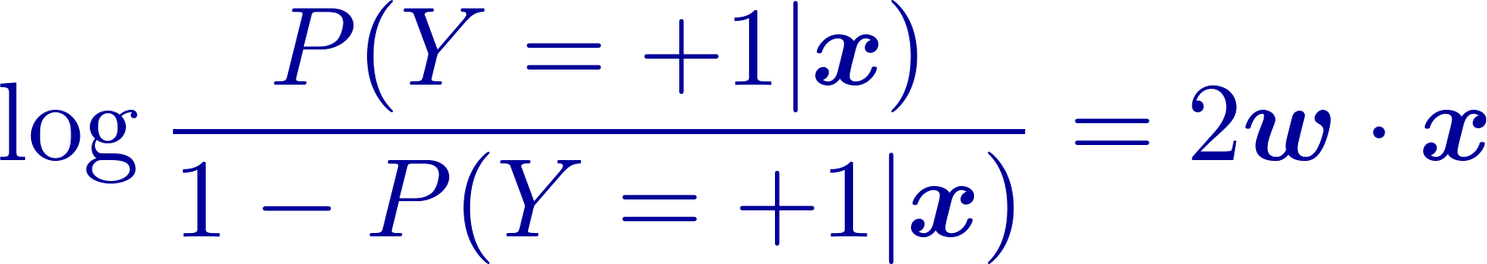
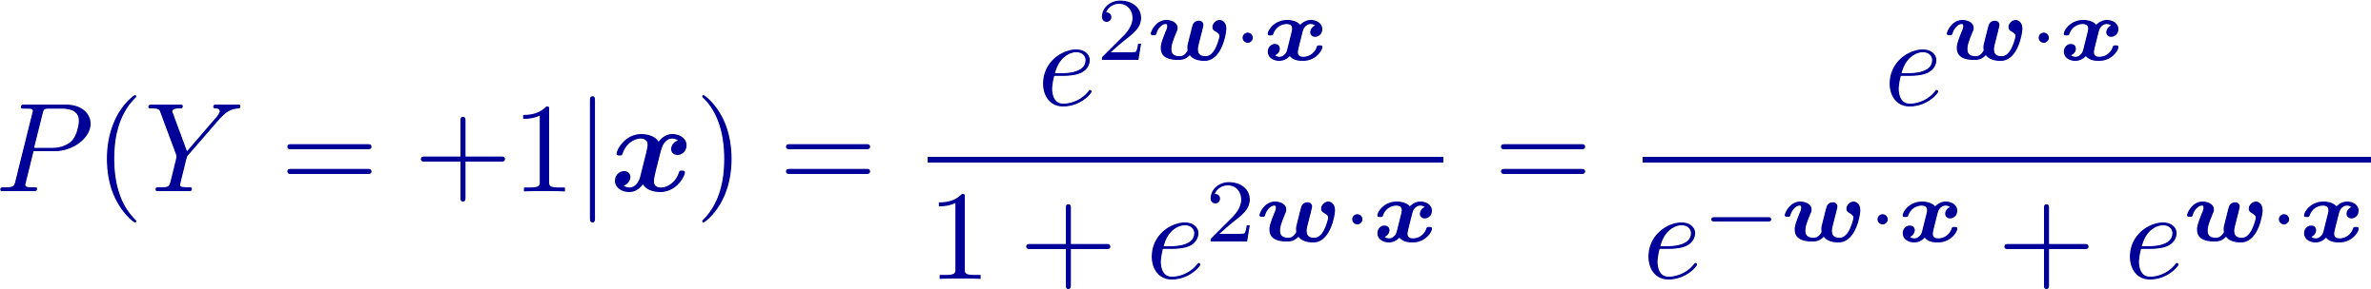
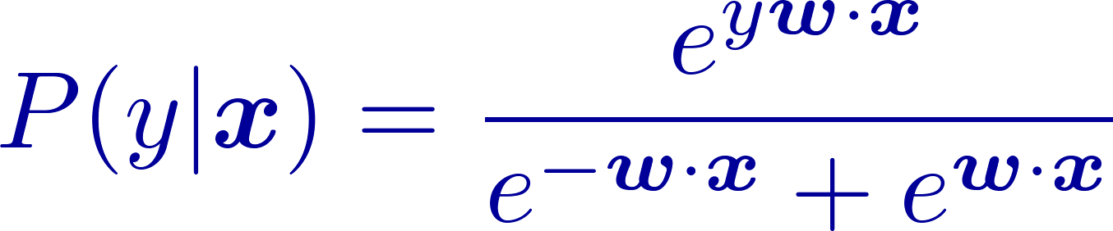
Logistic Regression: Model
Model:
Probability of label :
Compact form:

Slide 16
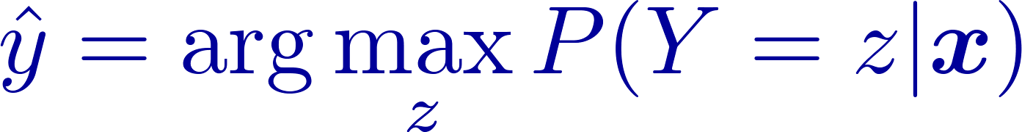
Logistic Regression: Prediction
Pretend it is the correct model, use Bayes-optimal
Maximum a-posteriori

Slide 17
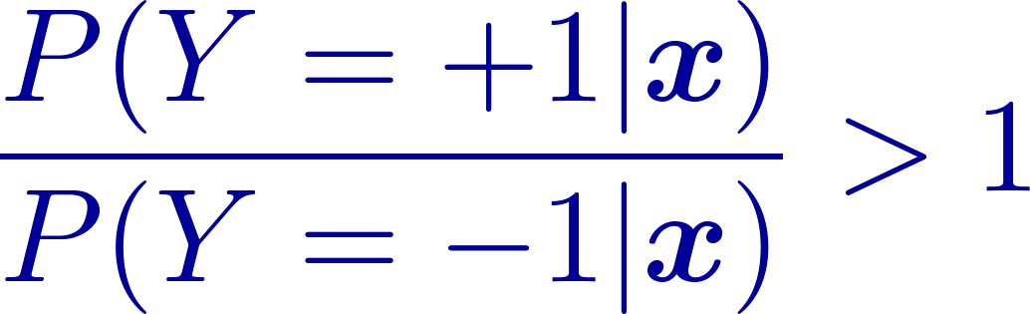
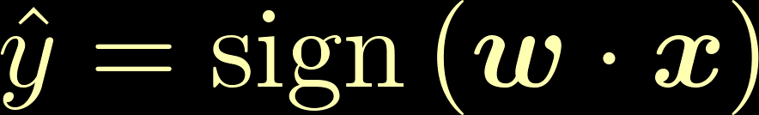
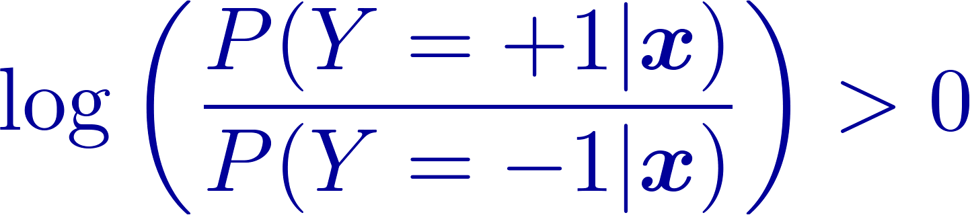

Logistic Regression: Prediction
Predict class +1 iff
Maximum a-posteriori prediction is
linear classification

Slide 18
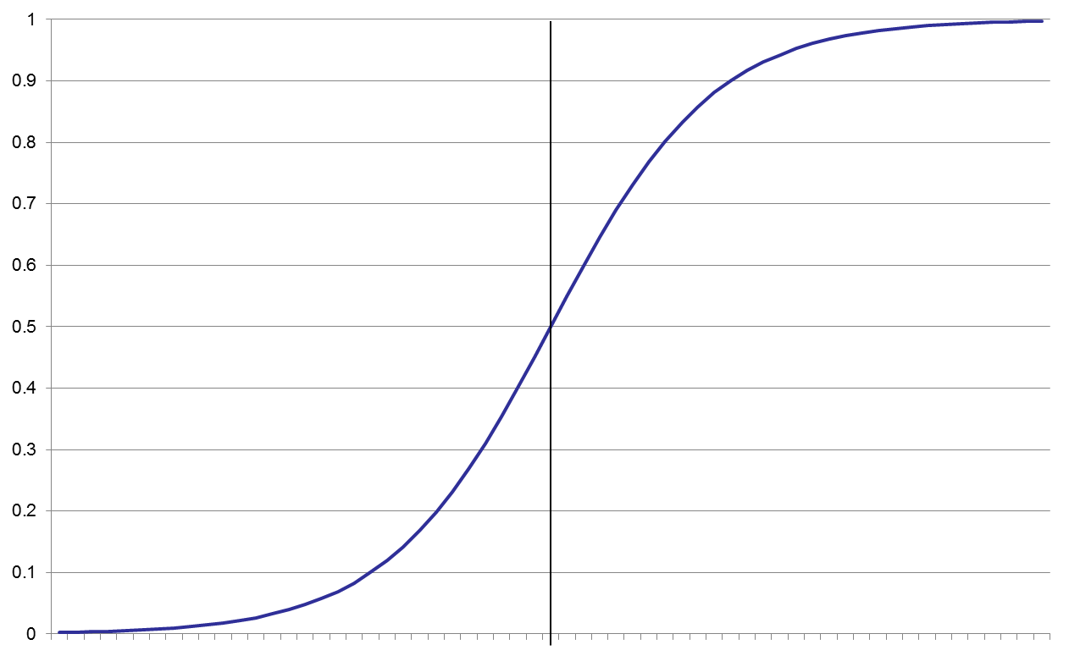
Logistic Regression: Prediction

Slide 19
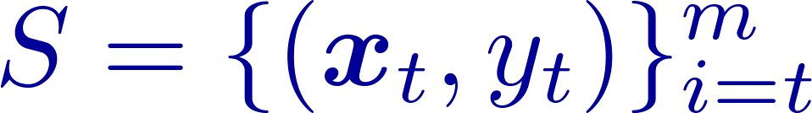

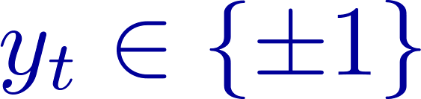

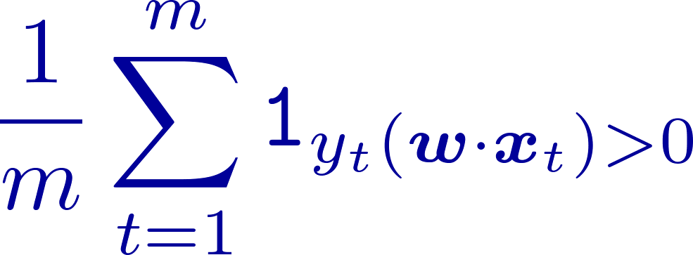
Logistic Regression: Learning
Given training set
Find a good parameters-vector:
How we define what is “good”?
  Minimize training error
Hard: not continuous, nor convex

Slide 20
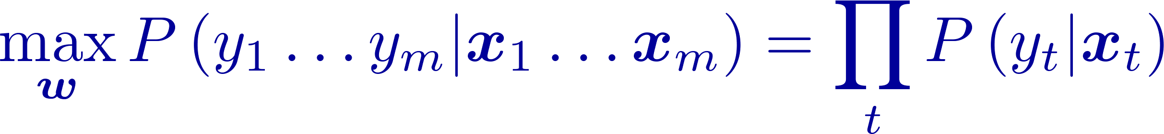
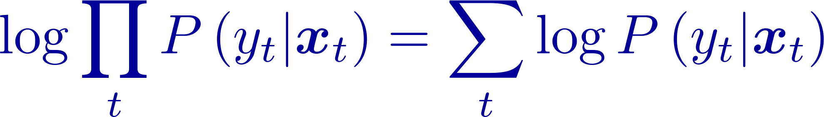
Logistic Regression: Learning
We have a probabilistic model, use it!
Maximize labels-probability of sample
Use monotonic function “log:

Slide 21
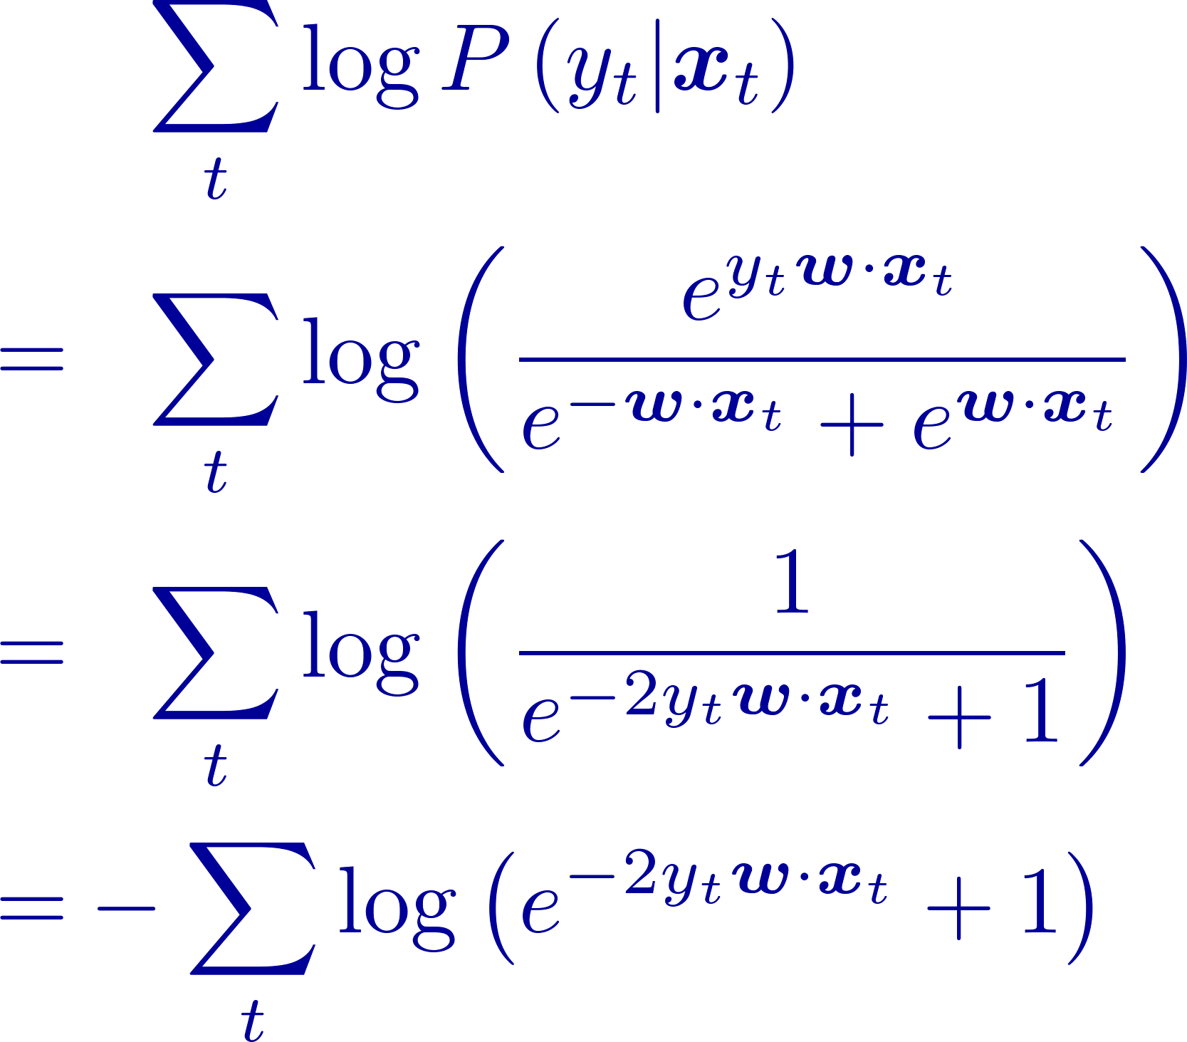
Logistic Regression: Learning
Substitute model:

Slide 22
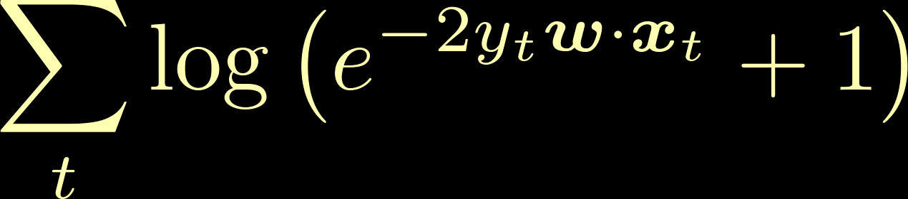
Logistic Regression: Learning
Substitute model:
Logistic Regression is minimizing
a sum of the log loss

Slide 23
Loss Functions

Slide 24
Logistic Regression: Comments
Equivalent to maximum conditional-entropy
Many algorithms to solve:
  e.g. gradient descent
Easley generalized to multi-class problems

Slide 25
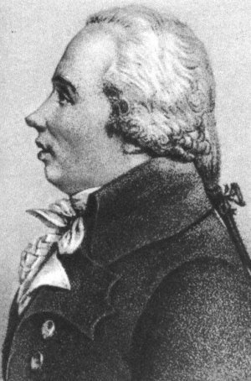
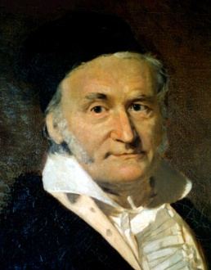
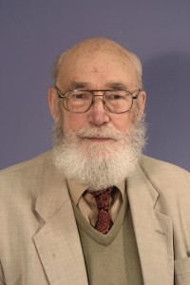
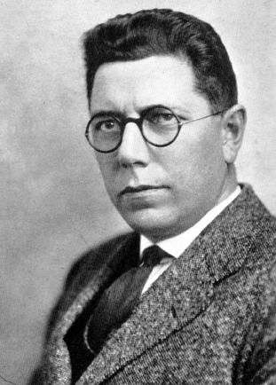
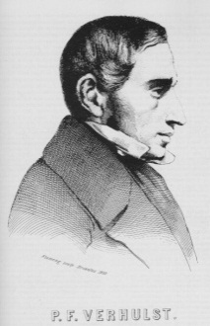
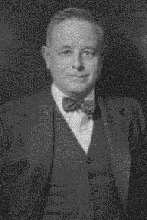
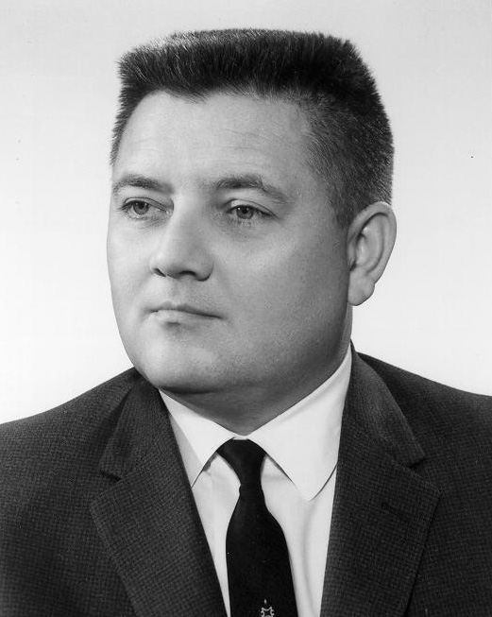
History
Regression
  Adrien-Marie Legendre, 1805
  Johann Carl Friedrich Gauss, 1809
  John Nelder and Robert Wedderburn, 1972
Logistic Regression
  Pierre Francois Verhulst, 1838,1845
  Pearl & Reed, 1920
  Joseph Berkson, 1944
  E.T. Jaynes, ~1950
Notes:
Lenendre and gauss developed methods in astronomy, predict path of orbits from measurements
Verhulst modeled population groath, pearl and reed developed later independently
Roseblatt modeled neuron activity in the brain
Vapnik -> large margin principle and kernel trick
F&S -> boosting + averaged perceptron
Note: astronomy, biology, and computer scientists …

Slide 26
Linear Models
Why compute probability
if
only want to make predictions?

Slide 27


Do not solve an estimation problem of interest by solving a more general (harder) problem as an intermediate step
Only care about decision boundaries

Slide 28

Linear Classifiers

Slide 29

Linear Classifiers

Slide 30
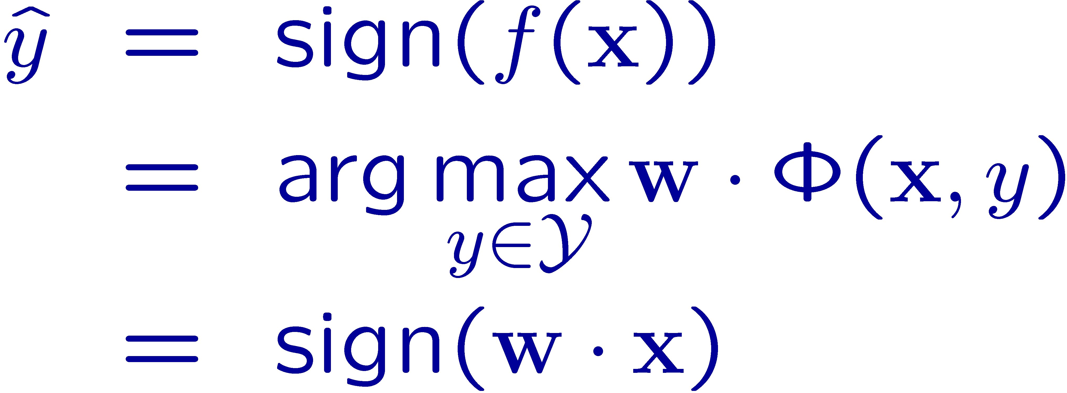

Linear Classifiers
Prediction :
Confidence in prediction:

Slide 31
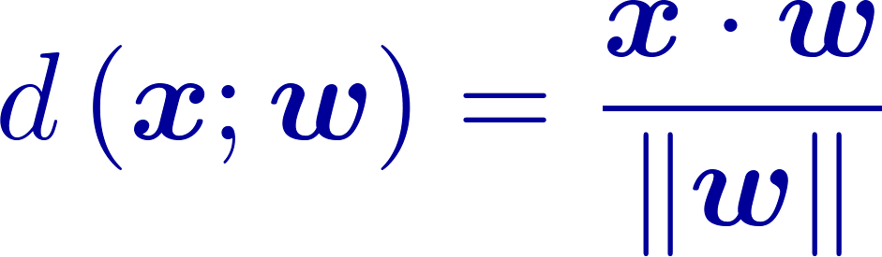
Signed Distance

Slide 32
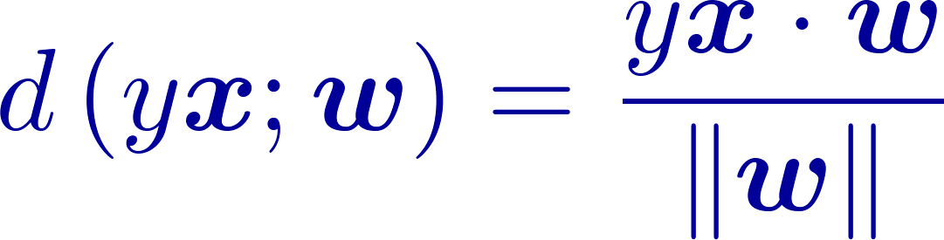
Margin
Margin <<0
Margin >0
Margin >>0
Margin <0

Slide 33
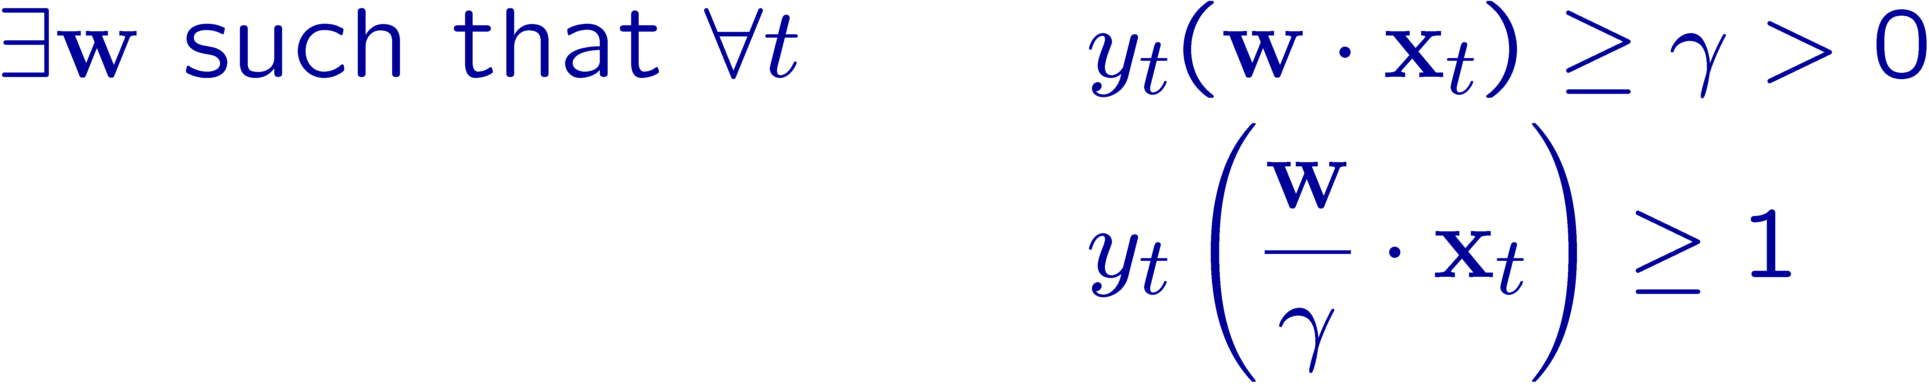

Separable Set

Slide 34
Inseparable Sets

Slide 35

Degree of Freadom - I
The same geometrical hyperplane can be representad by many paramter vectors

Slide 36
Degree of Freadom - II
Problem difficulty does not change if we shrink or expand the input space

Slide 37
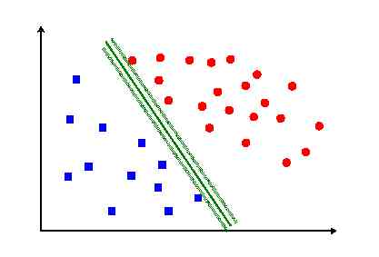
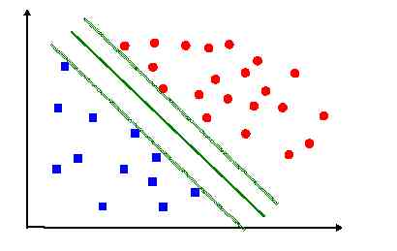
Large Margin Classification

Slide 38
Support Vector Machines
Learning to maximize the margin

Slide 39
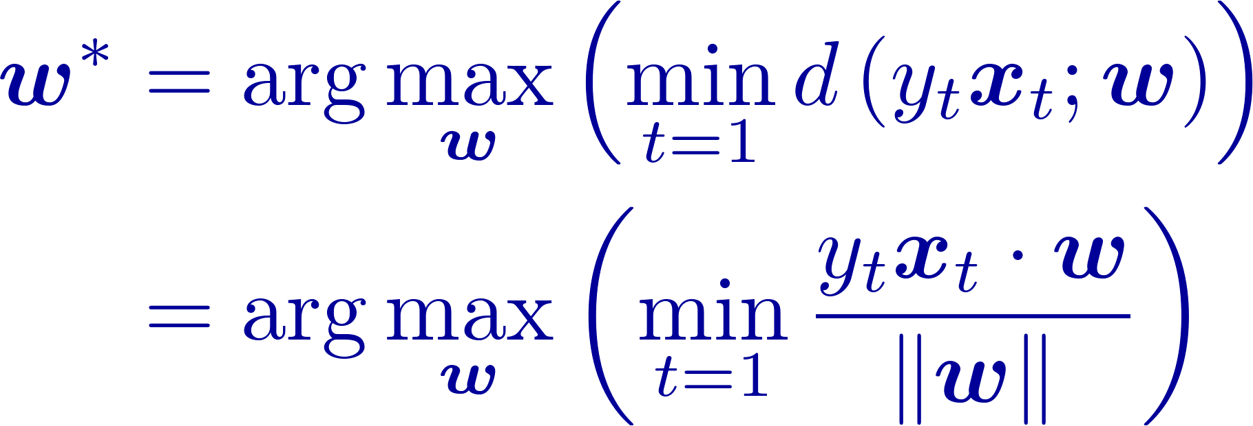
Support Vector Machines
Assume input data is separable
Find hyperplane with maximal (sample-)margin
Equivalent, find hyperplane such that
  Closest point to the hyperplane …
  … will be as far as possible from it

Slide 40
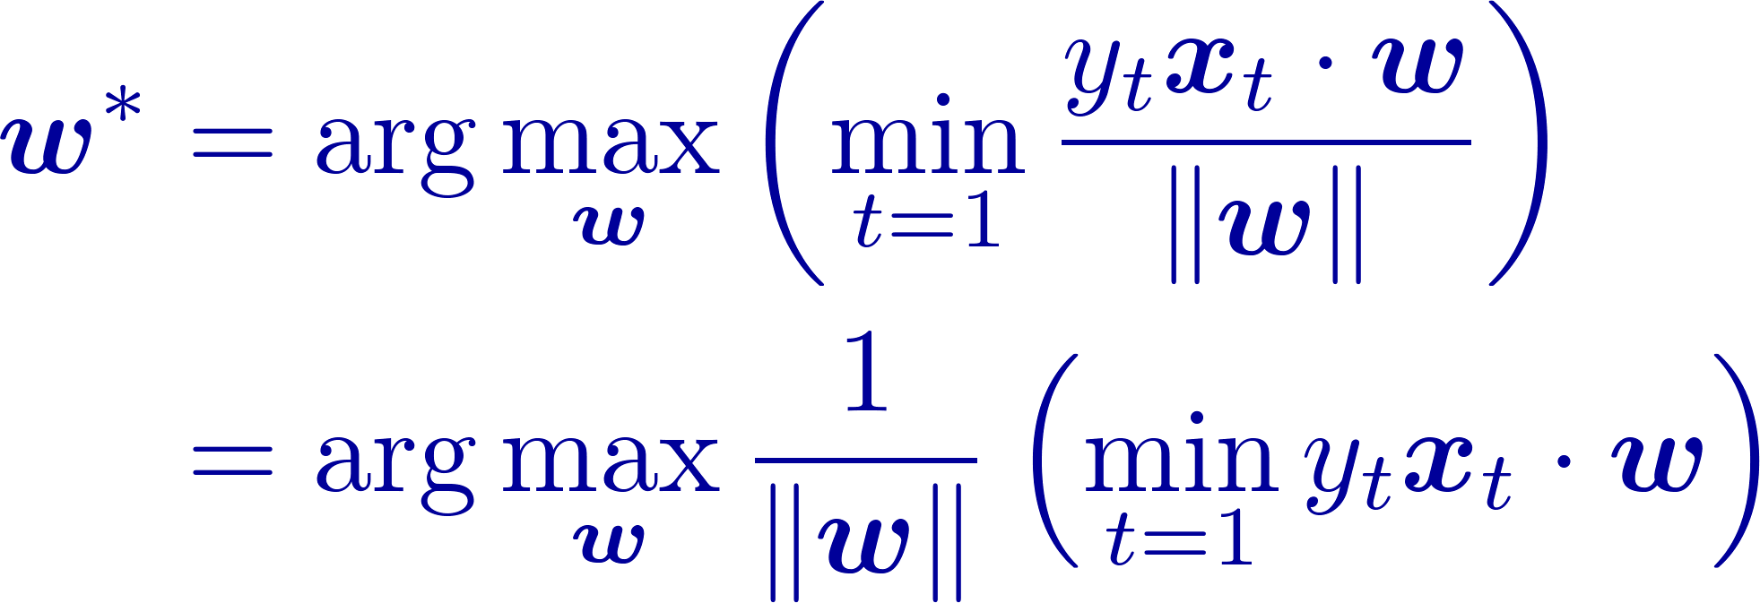
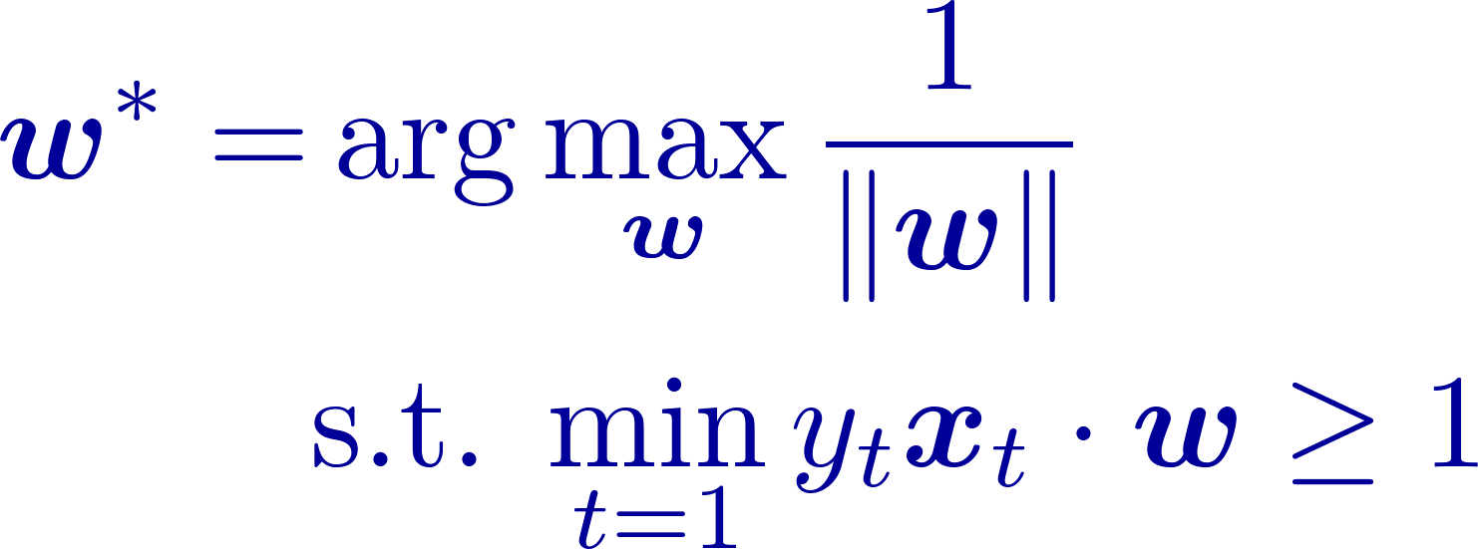
Support Vector Machines
Use first degree of freedom

Slide 41

Support Vector Machines
Primal Separable SVM
Algebra:

Slide 42
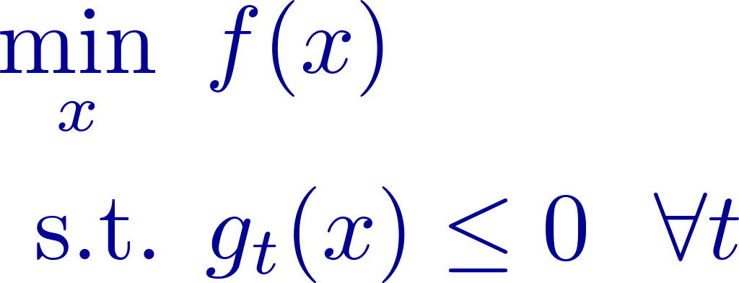
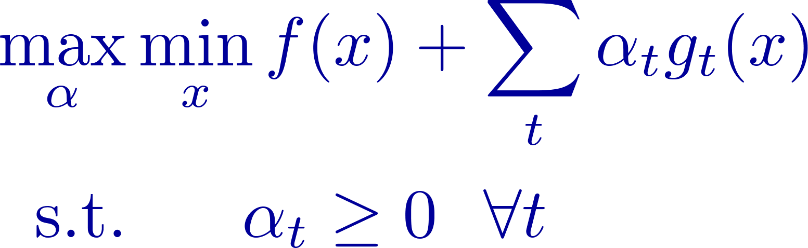
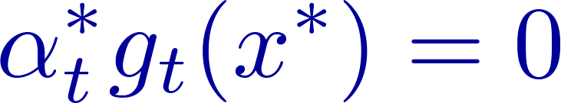
Lagrange Theory
Problem:
Min-Max game:
KKT conditions:

Slide 43



Lagrangian
Taking the derivative with respect to
Optimal solution

Slide 44


Support Vector Machine
Optimal Solution:
KKT conditions:
For a specific example:
Only examples that lie on the boundary affect the classifier

Slide 45

Support Vectors

Slide 46

Dual Formulation
Rewriting the Lagrangian
Substituting back in the Lagrangian

Slide 47

Dual Formulation
Rewriting the Lagrangian
Substituting back in the Lagrangian

Slide 48

Dual Formulation
Rewriting the Lagrangian
Substituting back in the Lagrangian

Slide 49

Dual Formulation
Rewriting the Lagrangian
Substituting back in the Lagrangian

Slide 50
Dual Formulations
From features to kernels

Slide 51


Dual Formulation
Making Predictions:

Slide 52

Inner-Product
Learning and Inferring/predicting can be computed via inner-products between inputs
No need to know inputs explicitly

Slide 53


Feature Mapping
Use feature mapping
Learning and inference become:

Slide 54
From Features to Kernels
Problem:
  Computing features can infeasble
Wish:
  Efficiently compute the inner-product directly

Slide 55


From Features to Kernels
Learning:
Inference:

Slide 56




Kernels
Let
Properties:
  Symmetric
  Given a finite set of inputs
  define a matrix
  then the matrix is positive semi-definite
Theorem

Slide 57


Example
Consider 2-d inputs, define:
Then:

Slide 58

Example
Consider 2-d inputs, define:
Then:

Slide 59


Kernels

Slide 60

Kernels
Common:
  Polynomial
  RBF
Crafted:
  e.g. String kernels, tree kernels
Learned:
  using SDP, boosting ...
Then:

Slide 61
Non-Separable Formulation
Hinge Loss + Regulrization

Slide 62

What is better?

Slide 63


Support Vector Machines
Primal Non-Separable SVM
Add slacks

Slide 64
Hinge Loss
Rewrite constraints

Slide 65


Hinge Loss
Regularization
Tradeoff Parameter
Hinge Loss

Slide 66

Support Vectors

Slide 67






Hinge Loss

Slide 68


Non-Separable Formulation

Slide 69

Dual Non-Separable
Learning:
Inference:

Slide 70
Comments
SVM: quadratic objective + linear constraints
Principle of large margin:
  Not only be correct, be also confident
Kernels
Bias term – class prior
Many many algorithms to solve optimization
Variants for:
  regression, ranking, multi-class, multi-label, structured prediction …

Slide 71
The Common and Different
Naïve Bayes, Logistic Regression and SVMs employ linear models
Generative vs. Discriminative
Probabilistic output?
Minimization of Regularization + Loss
  Log loss, Hinge loss, Exp loss, Huber loss …
  Squared L2, L1, L-infinity, …
Many algorithms can be combined with kernels, including logistic-regression
Generalization theory

